Slide 1
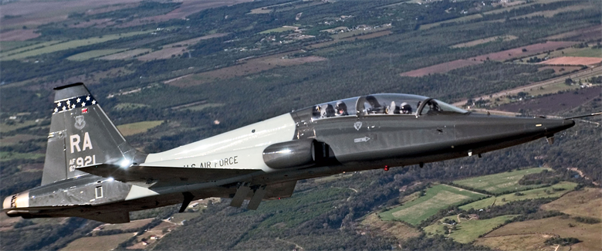
Comparison of Machine Learning Algorithms on Detecting Anomalous Behavior in Aircraft Data
Avantika Ghosh| SEAP 2018 | Naval Postgraduate School

Slide 2
How can we use machine learning to detect anomalous behavior in aircrafts, such as potential spy crafts and excessive autopilot usage?
Research Question
Notes:
This is the question that your experiment answers

Slide 3
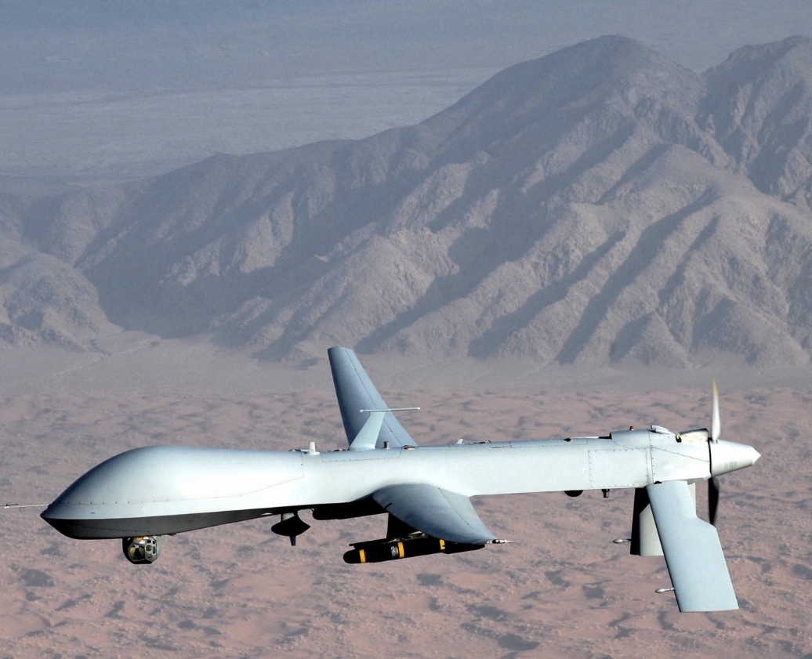
Importance to Military
Why does the Department of Defense use aircrafts?
To securely transport troops and supplies
Prevent spy craft activity
Prevent excessive autopilot usage
Other anomalous Behavior

Slide 4
Hypothesis
By analyzing patterns resulting from testing aircraft data on various machine learning algorithms, it is possible to identify potential outliers or anomalies in the dataset that suggest excessive autopilot usage or spy crafts.

Slide 5
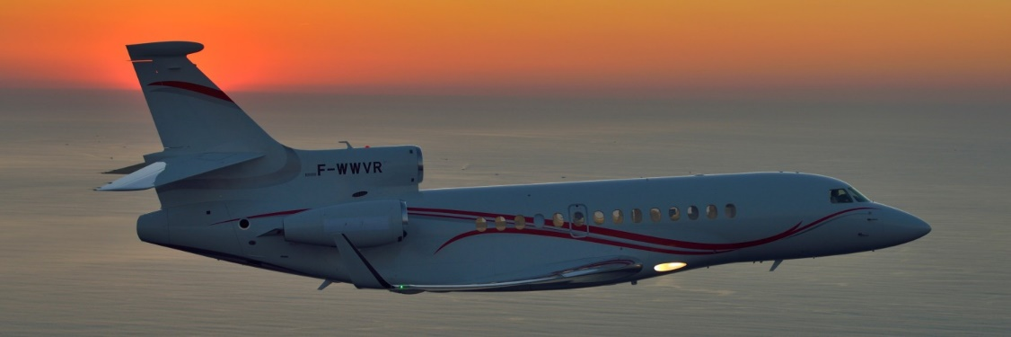
Background
Open source data from ADS-B Exchange
Over 60 different points being collected per active aircraft per minute
Currently, we are using ~8.5 GB
1000+ files of aircraft data everyday
Notes:
Summarize your research in three to five points.

Slide 6
Clustering Algorithms
K-Means Clustering
Support Vector Regression
DBSCAN
Clusters datasets into groups that share similar characteristics
Compares data using two features with a “line of best fit”
Clusters datasets into groups with specific parameters

Slide 7
Selected Feature Pairs
acList_PosTime vs acList_Mlat
acList_Mdl vs acList_EngType
acList_Tsecs vs acList_CMsgs
The time the position was last reported by aircraft vs If the position was calculated by a server
Aircraft model (Manufacturer) vs Type of engine
The time an aircraft is tracked for vs The number of messages the aircraft sends

Slide 8
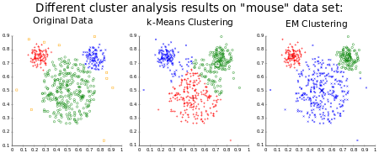
K-Means Clustering
Clustering method to partition a number of observations (n) into a number of clusters (k)
Determined by finding the nearest mean (centroid) of each cluster using Euclidean Distance Calculator
Notes:
Summarize your research in three to five points.

Slide 9
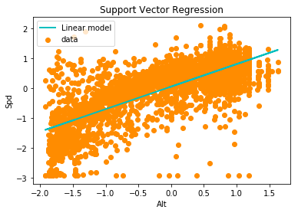
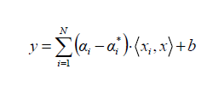
Support Vector Regression
Find a function or “line of best fit” that explains the correlation between given inputs
Compare similarities and patterns between characteristics of the aircraft data
Notes:
Summarize your research in three to five points.

Slide 10
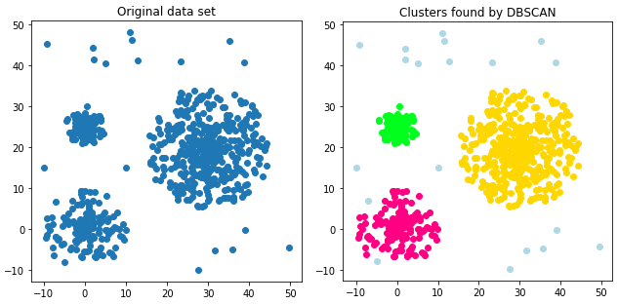
DBSCAN
Density-Based Spatial Clustering Applications with Noise
Groups together points that are closely packed together, marked as regions with high densities of points (Outliers are identified as regions with low density of points)
Control specific parameters:
Epsilon
minPoints
Notes:
Summarize your research in three to five points.

Slide 11
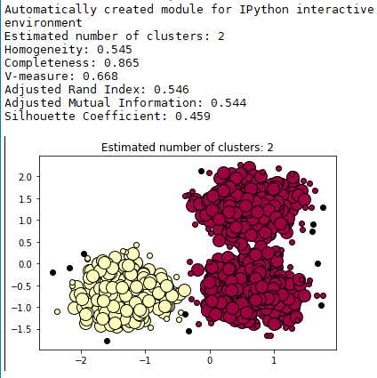
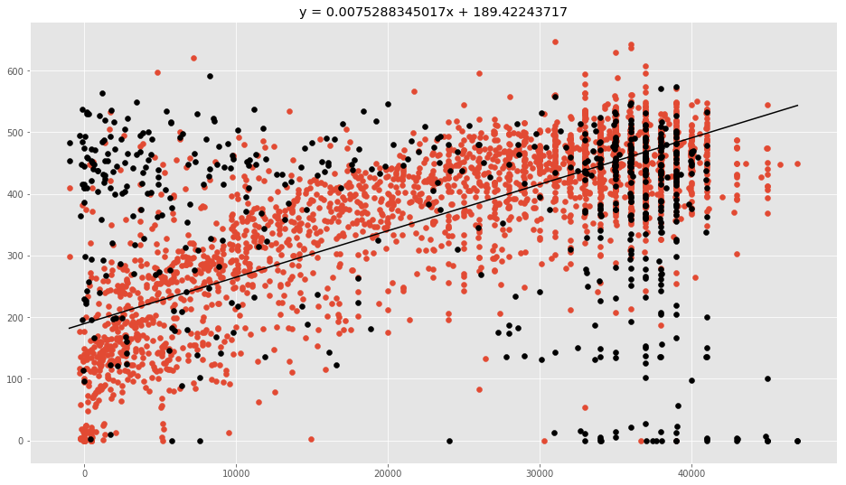
Conclusions
DBSCAN
Support Vector Regression (Linear Regression)
# of Messages
# of Messages
Time Tracked
Time Tracked

Slide 12
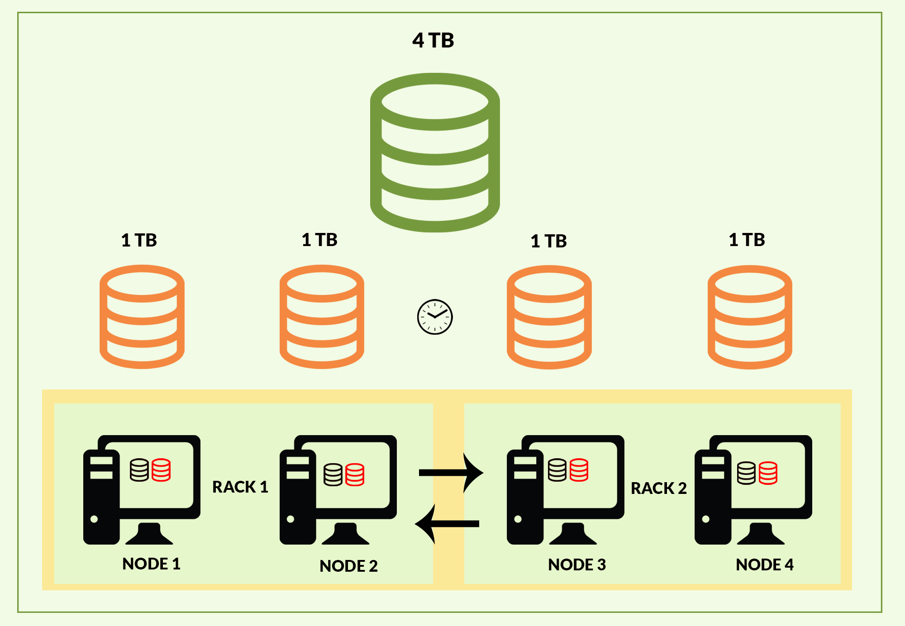
Future Work
Move functioning machine learning algorithms to Hadoop
Will enable us to use significantly larger datasets for analysis (Gigabytes to terabytes)
Process ten times more data quickly using Spark (processing engine)

Slide 13

Acknowledgements
SEAP, NPS, Alison Kerr, Professor Arijit Das, Professor Neil Rowe, Mr. James Zhou, Mitali Chowdhury

